Slide 1
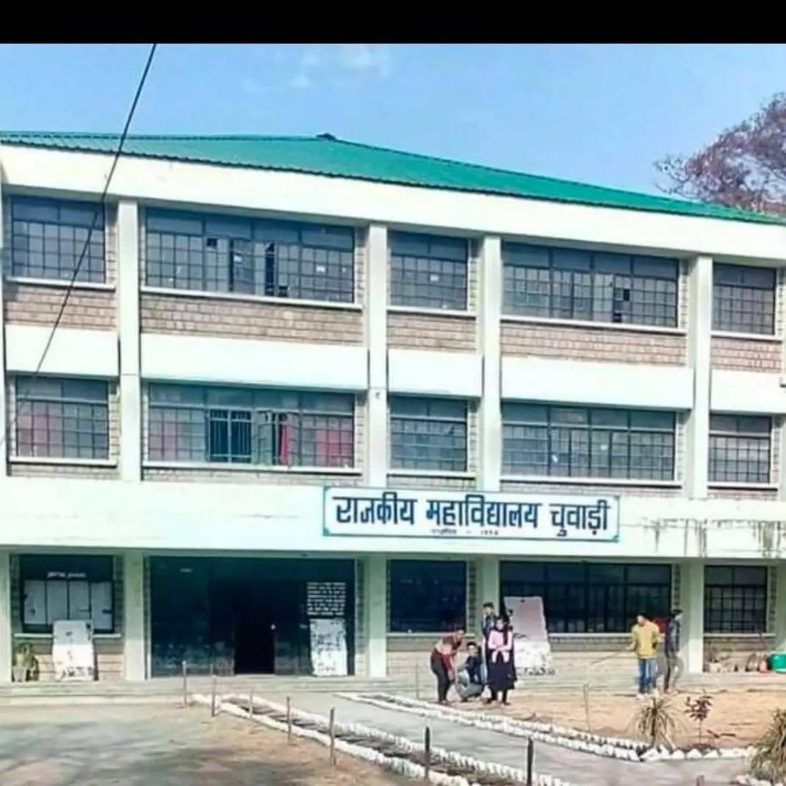
Govt. College Chowari
Distt. Chamba(H.P) PIN 176302
Email:gcchowari2013@gmail.com
website: gcchowari.edu.in
Contact Detail: 8629018160

Slide 2
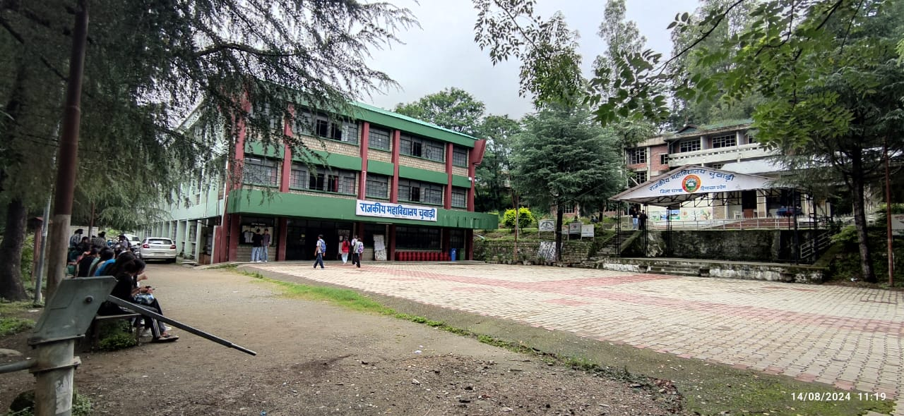
Front View of College Building

Slide 3
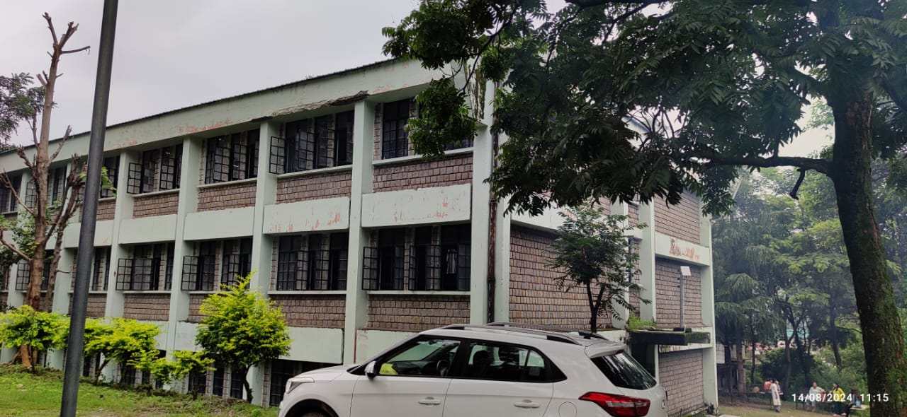
Side View & Back View of College Building

Slide 4
Students Enrollment w.r.t GC Chowari for last 5 Years
Sr. No. | Session | Girls(%age) | Boys(%age) | Total Enrolment
1. | 2019-20 | 636 (60%) | 431 (40%) | 1067
2. | 2020-21 | 593 (59%) | 407 (41%) | 1000
3. | 2021-22 | 691(59%) | 475 (41%) | 1166
4. | 2022-23 | 713 (62%) | 431 (38%) | 1144
5. | 2023-24 | 621 (63%) | 362 (37%) | 983

Slide 5
Current Students Strength w.r.t GC Chowari 2024-25 till 14.08.24
S. No | Course Name | Course Year | Male | Female | G. Total
1 | B.A. | 1 | 55 | 127 | 182
2 | B. Com. | 1 | 13 | 8 | 21
3 | B.Sc. Life Science | 1 | 1 | 10 | 11
4 | B.Sc. Physical Science | 1 | 16 | 18 | 34
5 | B.A. | 2 | 53 | 166 | 219
6 | B. Com. | 2 | 7 | 11 | 18
7 | B.Sc. Life Science | 2 | 0 | 5 | 5
8 | B.Sc. Physical Science | 2 | 14 | 8 | 22
9 | B.A. | 3 | 69 | 145 | 214
10 | B. Com. | 3 | 10 | 9 | 19
11 | B.Sc. Life Science | 3 | 4 | 17 | 21
12 | B.S.c. Physical Science | 3 | 9 | 10 | 19
 |  |  | 251 | 534 | 785

Slide 6
Students Achievement
Sports (Session 2023-24)
HPU Intercollege championships (Wrestling)
Sr. No. | Name | Class | Position/Ranking
1 | Miss Shweta | B. A. 2nd | Silver medal
2 | Tushar Charak | B.A. 1st | Bronze Medal
Academic session 2023-24
Ms. SUHANA D/O Sh. SUNIL SHARMA has got selected in M.Sc. Chemistry at IIT Kanpur and she was also CSCA president for session 2023-24.

Slide 7
Staff/Faculty Accomplishments
Dr. Vishal Sharma, Assistant Professor(Mathematics) has
Completed his Ph.D. in Mathematics on the topic Entitled “Generalized composition operators on the Besov and related Spaces”, from Central University, Jammu.
Dr. Sanjeev Kumar, Assistant Professor (Music V) has
Completed an online two-week interdisciplinary refresher course on “Research Methodology & Data Analysis” conducted by the Teaching Learning Centre, Ramanujan College, University of Delhi.
Presented a paper entitled, “Livelihoods in Folk Music: Opportunities and Challenges” in the national seminar organised by GC Sahpur.
Sh. Sidharth Sharma, Associate Professor (Physics) has
Completed an online two-week interdisciplinary refresher course on “Research Methodology & Data Analysis” conducted by the Teaching Learning Centre, Ramanujan College, University of Delhi.
Presented a paper entitled, “ Ethnobotanical Survey Of Medicinal Herbs From the Bhattiyat Region Of Chamba” at the International Conference on Communicating Health, Happiness & Longevity for Sustainable Growth organized w.e.f. Dec. 2 to Dec. 4, 2023 by GC Anni & ICFRE, Shimla.
Presented a paper entitled, “Effect Of Anthropogenic Activity On Climate: A Case Study Of Himalayan States In India” at the International Conference on Resilient Futures held on Dec. 29, 2023 and organized by GC Palampur.
Smt. Beby Kumari, Assistant Professor (Economics) has
Presented a paper entitled “Migration of tribes (Gaddis) from native land to Plains: An opportunity or threat”.

Slide 8
Sh. Pitamber Dutt, Assistant Professor (Botany) has
Presented a research paper entitled, “Cross-transferability of Wheat SSR Markers to Polygonatum verticillatum L. Accessions ” at the conference “ESBSTCR 2024” at SBBSU, Jalandhar.
Also presented a research paper “Impact of Grazing Animal on the Population of Polygonatum verticillatum in khajjiar region” in the National Conference at GC Sarkaghat.
Attended a one-week in-service teacher capacity building programme organized by GCTE, Dharamshala from 07/08/2023 to 12/08/2023.
Dr. Akash Deep Sharma Assistant Professor (Physics) has
Attended a one-week in-service teacher capacity-building programme organized by GCTE, Dharamshala from 07/08/2023 to 12/08/2023.
Presented a research paper at an International Conference on “Role of Science and Technology in Sustainable Development”.
Also completed a refresher course on “Managing Online Classes and Co-creating MOOCs”.
He has become a member of the Editorial Board of “Universal Journal of Physics Research” and the Reviewer member of the journal “Materials Letters”.

Slide 9
Dr. Amrita, Assistant Professor(Mathematics) has
Completed a two-week refresher course in Mathematics from 29.04.2023 to 13.05.23 organized by the Teaching Learning Centre, Ramanujan College, University of Delhi.
Completed a two-week interdisciplinary refresher course in Research methodology and data analysis from 14.12.2023 to 28.12.23 organized by the Teaching Learning Centre, Ramanujan College, University of Delhi.
Sh. Aman Kumar, Assistant Professor (Chemistry) has
Completed a refresher course on “Managing Online Classes and Co-creating MOOCs”.
Dr. Manoj Kumar, Assistant Professor (Zoology) has
Published a paper entitled “Protective role of AKBA against benzo(a)pyrene-induced lung carcinogenesis by modulating biotransformation enzymes and oxidative stress” in the Journal of Biochemistry and Molecular Toxicology. 2022 Jul;36(7):e23072. doi: 10.1002/jbt.23072. Epub 2022 Apr 19. PMID: 35437857. ISSN:1099-0461, impact factor 3.5.
Published a paper entitled “Exploring integrative approaches : EGCG's potential in combating prostate cancer” in the World cancer research journal. 2024; WCRJ 2024; 11: e2744 DOI: 10.32113/wcrj_20242_2744; ISSN 2372-3416; impact factor 1.2; volume and page number not assigned yet.
Completed a two-week interdisciplinary refresher course in Research methodology and data analysis from 14.12.2023 to 28.12.23 organized by the Teaching Learning Centre, Ramanujan College, University of Delhi

Slide 10
Dr. Roop Lal, Assistant Professor (Botany) has
Completed an online two-week interdisciplinary refresher course on “Research Methodology & Data Analysis” conducted by the Teaching Learning Centre, Ramanujan College, University of Delhi.
Presented a paper entitled, “Ethnobotanical Survey Of Medicinal Herbs From the Bhattiyat Region Of Chamba” in the Internal Conference on Communicating Health, Happiness & Longevity for Sustainable Growth held w.e.f. Dec. 2 to Dec. 4, 2023 and organized by GC Anni & ICFRE, Shimla.
Published a Research Paper entitled “Projected Impacts of Climate Change on the Range Expansion of the Invasive Straggler Daisy (Calyptocarpus vialis) in the Northwestern Indian Himalayan Region” in the issue Dated 25th Dec. 2023 of the reputed Journal “Plants” having an Impact Factor 4.5.
Hans Raj, Assistant Professor (English) has
Completed an online two-week interdisciplinary refresher course on “Research Methodology & Data Analysis” conducted by the Teaching Learning Centre, Ramanujan College, University of Delhi.
Vipan Kumar, Assistant Professor (Sanskrit) has
Attended one-week in-service induction programme (orientation) held at GCTE, Dharamshala w.e.f. 24/07/2023 to 29/07/2023.
Balbir Singh, Assistant Professor (English)
Attended one-week in-service induction programme (orientation) held at GCTE, Dharamshala w.e.f. 24/07/2023 to 29/07/2023.

Slide 11
Teaching Vacancy Position w.r.t G C Chowari
Subject | Total sanctioned posts | Filled |  |  | Vacant | Local PTA if any
 |  | Regular | Contract | PTA(GIA)
Principal | 01 | 01 | ----- | ------ | Nil
English | 02 | 01 | 01 | ------- | Nil
Hindi | 01 | ----- | 01 | ------- | Nil
Sanskrit | 01 | -------- | 01 | ------ | Nil
Sociology | 01 | 01 |  |  | Nil
History | 01 | 01 | ------ | ------- | Nil
Political Science | 01 | 01 |  |  | Nil
Geography | 01 |  | 01 |  | Nil
Music(I/V) | 02 | 01 |  |  | 01
Public Administration | 01 |  | 01 | ------ | Nil
Economics | 02 | 01 | 01 | -------- | Nil
Chemistry | 02 | 02 |  |  | Nil
Physics | 02 | 02 |  |  | Nil
Zoology | 01 | 01 |  |  | Nil
Botany | 02 | 02 |  |  | Nil
Mathematics | 02 | 01 | 01 |  | Nil
Commerce | 02 | 01 |  |  | 01 | (1)Local PTA
Physical Education | 01 | ---- | ------ | ------ | 01
Librarian | 01 | 01 |  |  | Nil
Total | 27 | 17 | 07 |  | 03

Slide 12
Non-teaching Vacancy Position W.r.t GC Chowari
 | Sanctioned | Filled | Vacant
Supdt. Grd. I | 01 | 0 | 01
Supdt. Grd. II | 01 | 01 | Nil
Sr. Asstt. | 01 | 0 | 01
Clerk/JOA-IT | 01 | 01 | Nil
SLA | 02 | 02 | Nil
JLA | 02 | 0 | 02
Tabla Vadak | 01 | 00 | 01
LA | 02 | 00 | 02
Store keeper | 01 | 00 | 01
Peon cum Chowkidar | 07 | 07 | Nil
Mali | 01 | 0 | 01

Slide 13
Detail of Expenditure (Salary, OE, TE & MR) last 05 F.Y’s
Year | Budget allotted | Expenditure incurred | Excess/Saving | Fund surrendered
2018-19 | 225.88 | 204.46 | 21.42 | 21.42
2019-20 | 235.04 | 227.66 | 7.38 | 7.38
2020-21 | 233.86 | 225.55 | 8.31 | 8.31
2021-22 | 240.92 | 235.73 | 5.19 | 5.19
2022-23 | 299.8 | 297.23 | 2.57 | 2.57

Slide 14
OBC Girls Hostel Incomplete due to land legal case in Hon’ble High Court
sanctioned amount ₹117.86 lakh
Expenditure
₹105.85 lakh
work was started on 16.03.2009
Court stay petition Date 10.08.2009

Slide 17
Recent initiatives towards academic & infrastructural development
07 Digital interactive panels funded by State Govt. (DHE.)

Slide 18
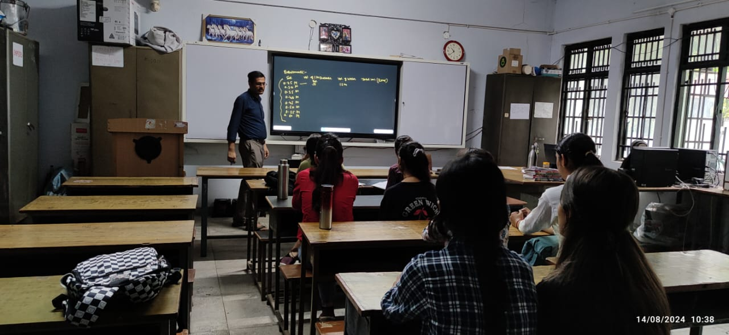

Slide 20
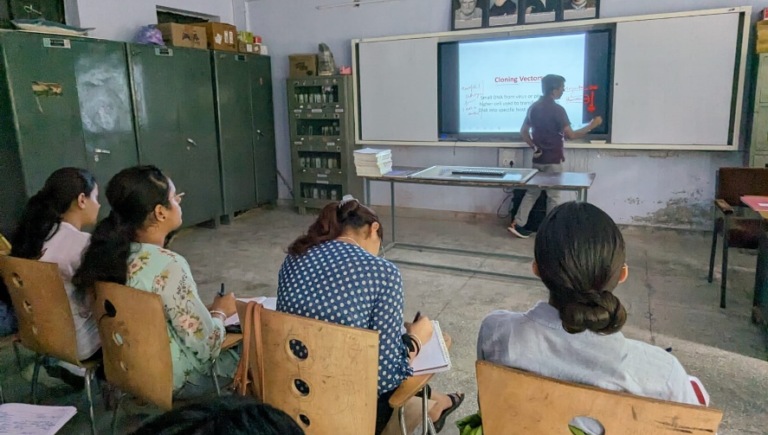

Slide 21
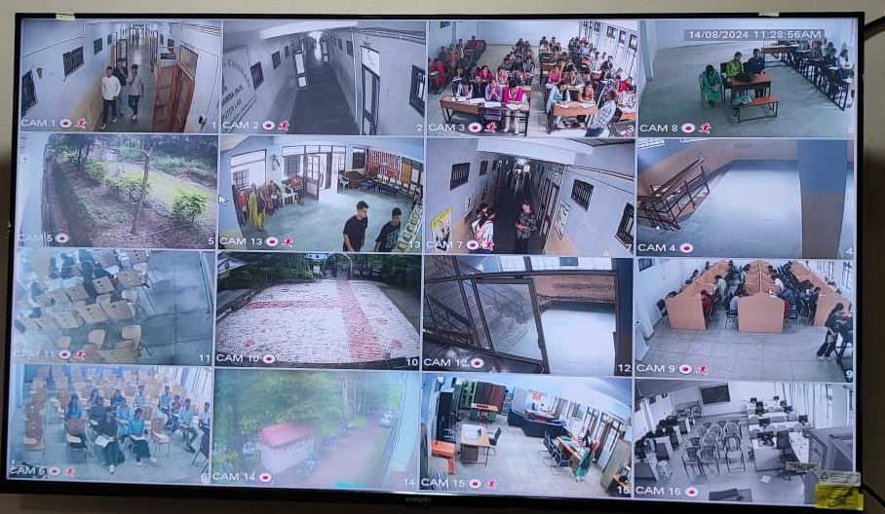
Improved CCTV surveillance system (Night vision /24X7/ 5TB Data Storage)

Slide 22
Online Digital Notice Board

Slide 24
Physics Lab. Equipped with latest apparatus

Slide 25
e-Library with Kiosks and SOUL 3.0 INFLIBNET Software

Slide 26
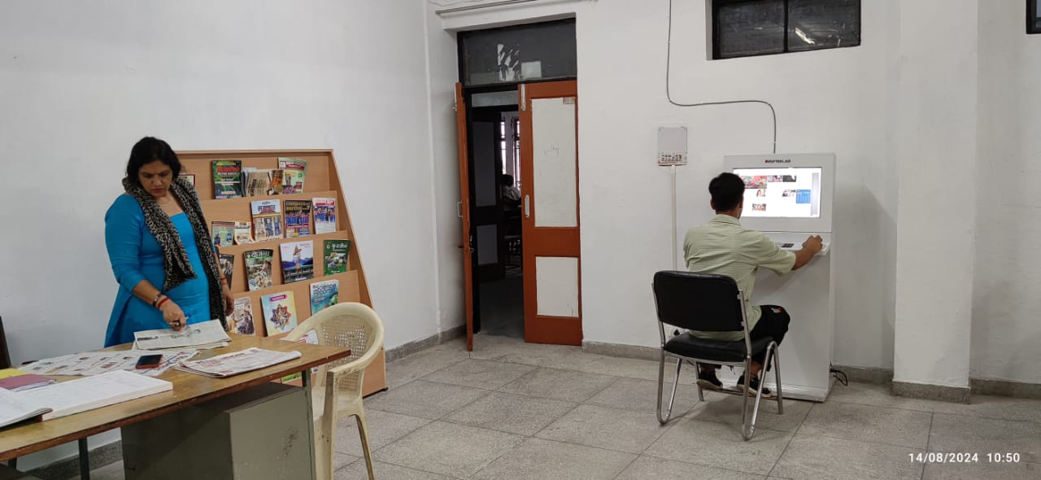

Slide 29
Dr. Radhakrishnan Book Bank Govt. College Chowari Distt. Chamba (H.P)
During the session 2023-24, new initiative in the context of College Library has been taken. The College has established Book Bank named as Dr. Radhakrishnan Book Bank, Govt. College Chowari. The purpose of establishment of this Book Bank is to provide books to needy and deserving students free of cost (without any Library refundable security). The student can get issued books as per their needs and requirement for the entire session also (if needed).
Presently in this book Bank 300 titles are available.
All these Books have been contributed by the College Faculty of different courses.

Slide 30
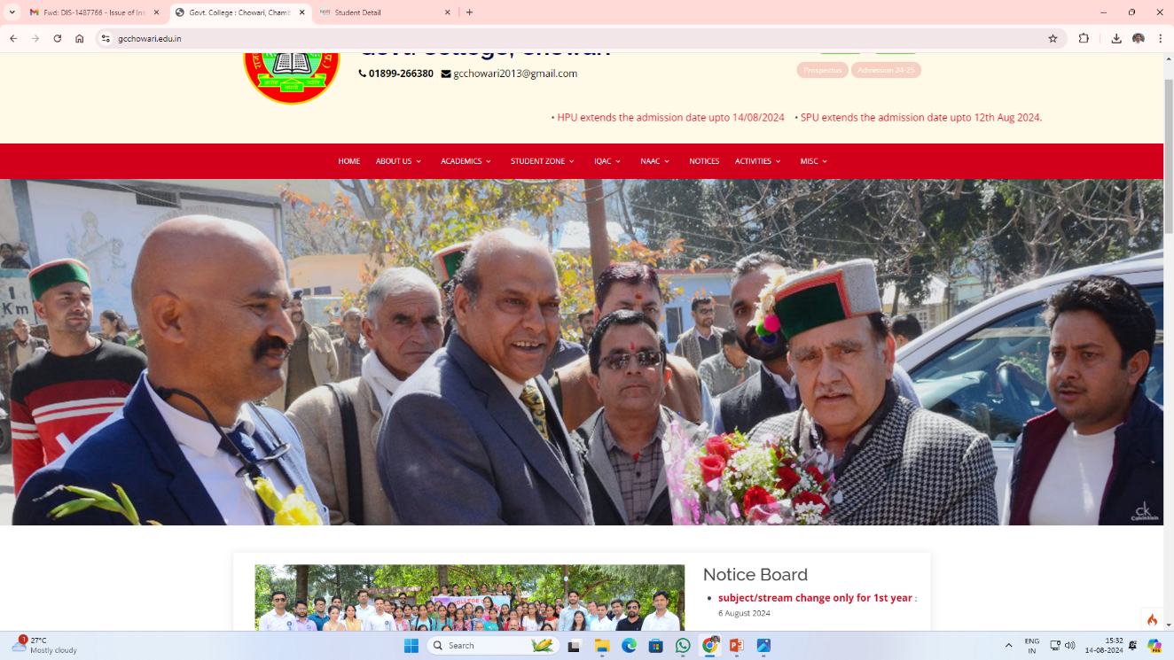
Upgradation of college website and admission through online mode

Slide 31
PM-USHA Proposal from GC Chowari
Head | Sanction | S.N | Items to be Purchased
(I) Infrastructure Renovation | 61,00,000/- | 01 | 10 Lac For Girls Common Room Two seater stainless steel bench 20 03 Centre Table Girls Convenience & Facilitation Center 03 Computer 02 Computer Chair 02 Computer Table 01 Printer Networking and Electricity fitting charges in Girls convenience & Facilitation Centre
 |  | 02 | (2) 21 Lac -IT Lab Furniture (30 Computer Chair, 30Computer Table, Office Table, Office Chair. Mainly for (Girls students)
 |  | 03 | 5 Lac- Repair and renovation of toilets for (Girls students)
 |  | 04 | (11) 22Lac -180 Two Seater Benches for 6 ultra modern classrooms for girls students. (Because there are 63% of girls in the college)
 |  | 05 | 3 Lac- for Internet Lease Line for IT Lab. Girls IT Lab and Girls Convenience & Facilitation Centre)
(II) Equipment Procured | 36,00,000/- | 01 | 30 Computer (30x90,000 = 27,00,000/-) 30 For IT Lab mainly for girls students (Because there are 63% of girls in the college)
 |  | i.
 |  | 02 | 4.5 Lac- Botany Lab Equipment.(Because there are more than 90% of Girls Students)
 |  | 03 | 4.5 Lac- Zoology Lab Equipment.(Because there are more than 90% of Girls Students)
III(1) Workshop | 2,00,000/-
IV (1) Remedial Class | 3,00,000/-
Total | 1,02,00000/-

Slide 32
Scholarships/Incentives
Total number of scholarship application verified at college level from 2018-19 to 2022-23
Session/Category | SC | ST | OBC | IRDP | EBC | KCCY | Disability | INSPIRE | Others (PTA) | Total
2018-19 | 2 | 26 | 1 | 3 | 5 | 9 | 0 | 3 | 0 | 49
2019-20 | 1 | 12 | 0 | 1 | 0 | 10 | 0 | 2 | 10 | 36
2020-21 | 3 | 14 | 0 | 1 | 0 | 12 | 0 | 0 | 0 | 30
2021-22 | 4 | 44 | 0 | 1 | 6 | 10 | 1 | 2 | 0 | 68
2022-23 | 25 | 159 | 10 | 0 | 36 | 13 | 1 | 0 | 0 | 244

Slide 33
GC Chowari has successfully completed RUSA
Sr. No | Name of Component | Grant received | Expenditure made
1 | Equipment (I.G.) | 20000000-00 | 60,00000-00 6061,871-00 (61871)
2 | Renovation/Upgradation(I.G.) |  | 70,-00000-00 72,01797-00 (201797)
3 | New/ Civil Work/New construction(I.G) |  | 9,13,320-00
 | Equity Initiative | 5,85,006-00 | 5,52,526-00
 | Bank Interest | 10,85,848-00 | 2,66,281-00
 | Sensitization Campaign. | 20,000-00 | 20,000-00
 | TOTAL EXPENDICTURE |  | 14176988/-

Slide 34
